Slide 1

FIFTH ANNUAL · SEPTEMBER 14, 2026 · THE STATLER DALLAS
Your Sales Team Isn’t the Problem.
Your System Is.
Giving the Sales Seat its Own Operating System
2026
Steve Heroux – Founder – The System of Selling
eosnorthtexas.com
#WeRunOnEOS2026

Slide 2

The thoughts and ideas you are about to hear are those of Steve Heroux, and only Steve Heroux, not EOS® Worldwide, not Shane or Kevin, or anyone else. ☺
#WeRunOnEOS2026

Slide 3


Slide 4
“
We run on EOS® and everything else got traction. Why is sales still the seat that keeps me up at night?
- Almost all Visionaries and Integrators
- Almost all Companies
#WeRunOnEOS2026

Slide 5




®
Steve Heroux
FOUNDER
steve@thesystemofselling.com
#WeRunOnEOS2026

Slide 6

Who Wins?

Slide 7

Does your revenue rely mostly on the Visionary?
#WeRunOnEOS2026

Slide 8
Are one or two superstar salespeople carrying sales?
#WeRunOnEOS2026

Slide 9
Have you replaced a salesperson, only to watch the next one fail?
#WeRunOnEOS2026

Slide 10

When a salesperson DOESN’T SELL because of…
Poor onboarding
No documented sales process
Lack of an effective sales leader
No customized coaching & development
#WeRunOnEOS2026

Slide 11
Or THEY HAD…
Unrealistic expectations & goals
Limited professional training
No accountability for behaviors
Poorly executed role play (if any)
#WeRunOnEOS2026

Slide 12

We blame the salesperson!
We rarely question the system.
YOUR SALES TEAM ISN’T THE PROBLEM
THE SYSTEM OF SELLING
12

Slide 13
Think about the last salesperson you put on a PIP or let go.
Get their initials in your head. Picture them.
2026
#WeRunOnEOS2026

Slide 14
#1: Did they have a world-class onboarding experience, as they would describe it?
#WeRunOnEOS2026

Slide 15
#2: Did they have a fully documented sales process, that was taught, practiced, coached, and role played?
#WeRunOnEOS2026

Slide 16
#3: Did they have defined entrance and exit criteria for each stage of the sales cycle?
#WeRunOnEOS2026

Slide 17
#4: Did they have specific daily activities they were held accountable for, tied to behaviors, not outcomes?
#WeRunOnEOS2026

Slide 18
#5: Did they have ongoing, individualized coaching, based on their specific strengths, gaps, and the way they sell?
#WeRunOnEOS2026

Slide 19




Did anyone have…
Three NOs?
Four NOs?
All Five NOs?
#WeRunOnEOS2026

Slide 20
You may be a great leader.
But the data shows us that most salespeople were never set up to succeed.
2026
#WeRunOnEOS2026

Slide 21

If nobody ever
showed you how to build a sales system, how would you know how?

Slide 22


The secret to success
lies in how you
TEACH
the system to someone.

Slide 23
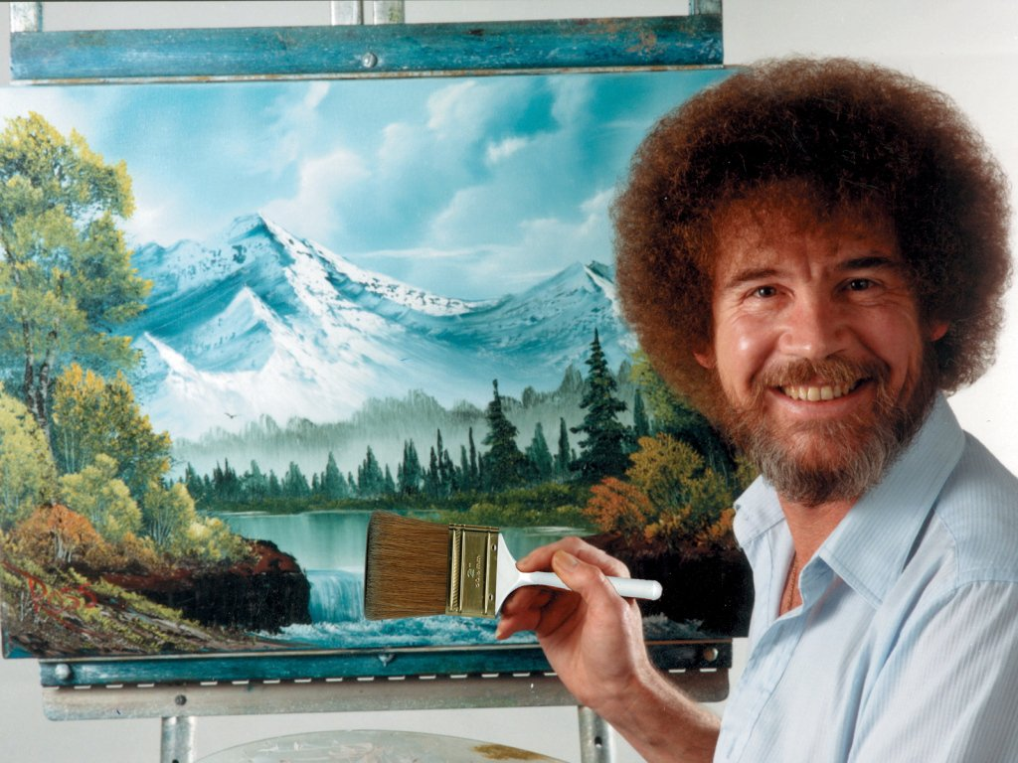

Slide 24
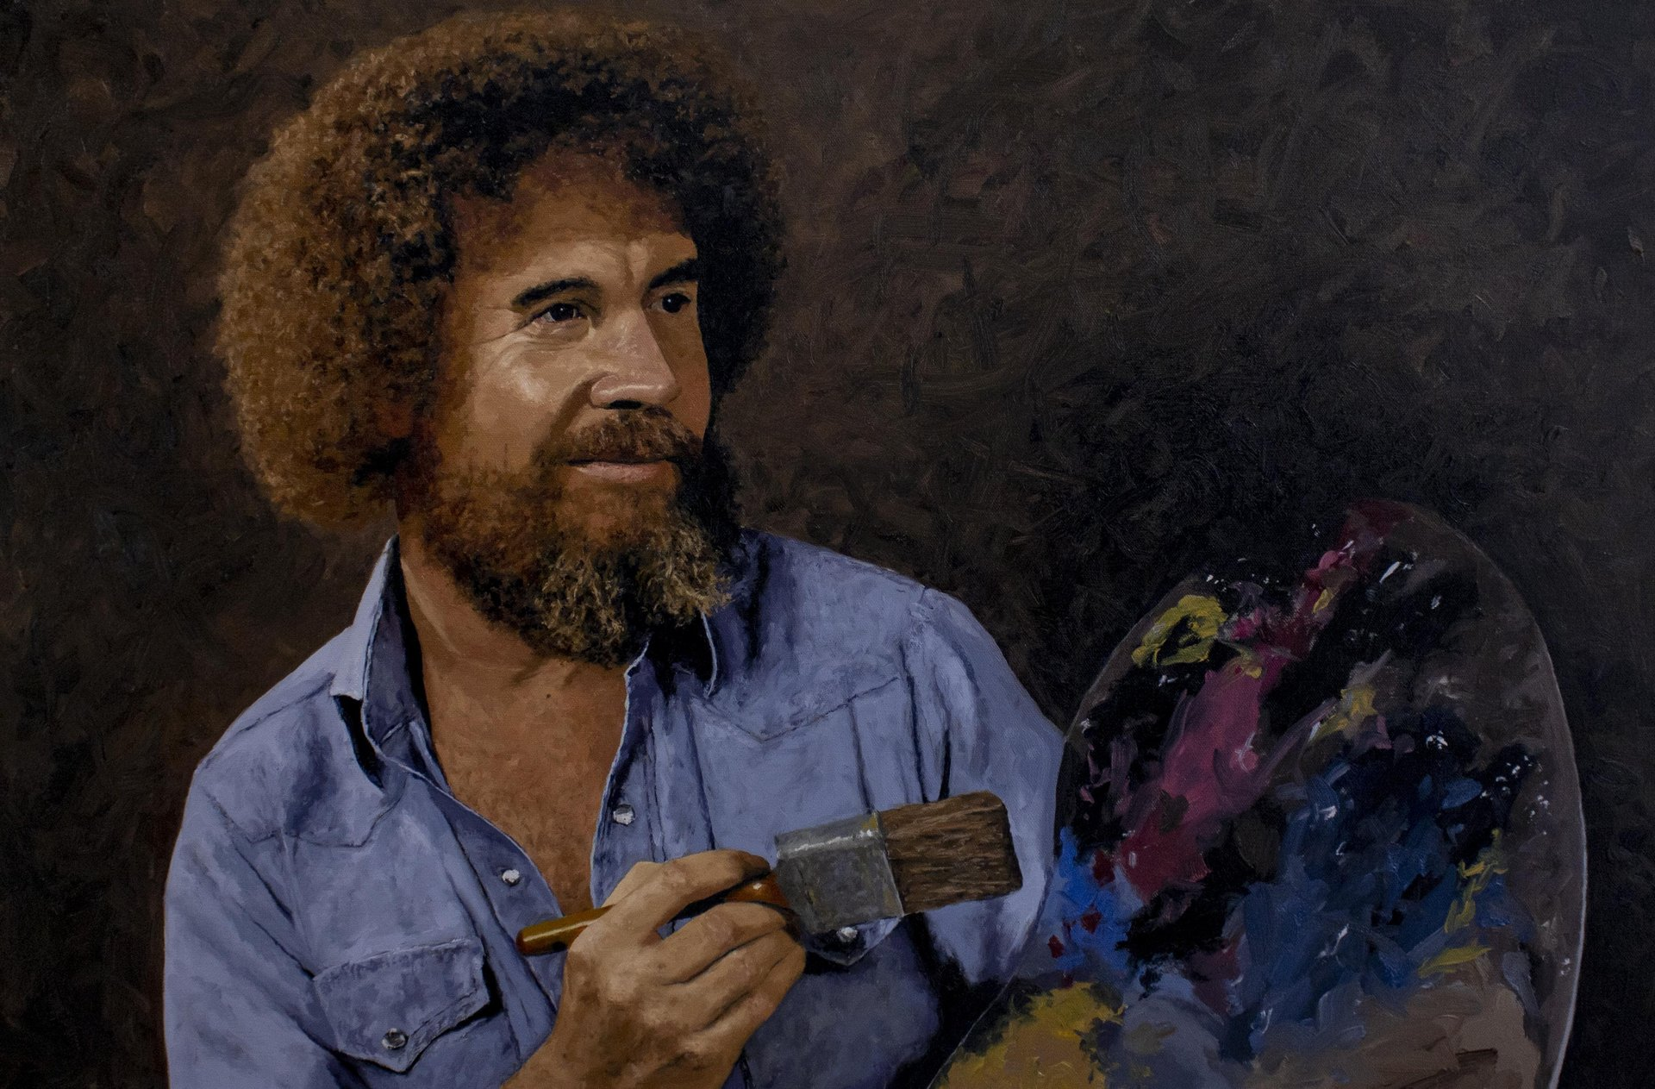
He didn’t paint to show how good of a painter he was. He painted to show how good of a painter you could be.

Slide 25

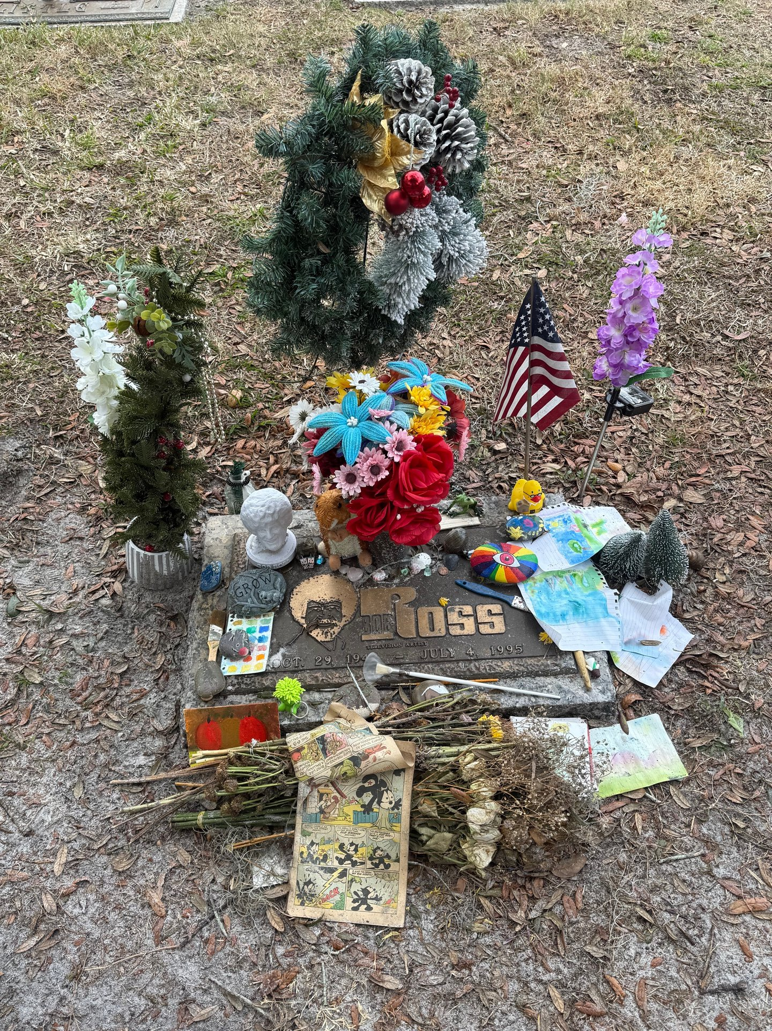

Slide 26
A chart you’ve seen a hundred times!
Visionary
Big ideas
Big relationships
Culture
R&D
Integrator
LMA
P&L
Remove obstacles
Special projects
Sales & Marketing
Operations
Finance
LMA
Revenue target
Sales process
Pipeline
LMA
Make the product
Deliver the service
Quality control
LMA
Budgets
Reporting
AR / AP
We are not affiliated with, endorsed by, or authorized by EOS Worldwide.

Slide 27


Slide 28
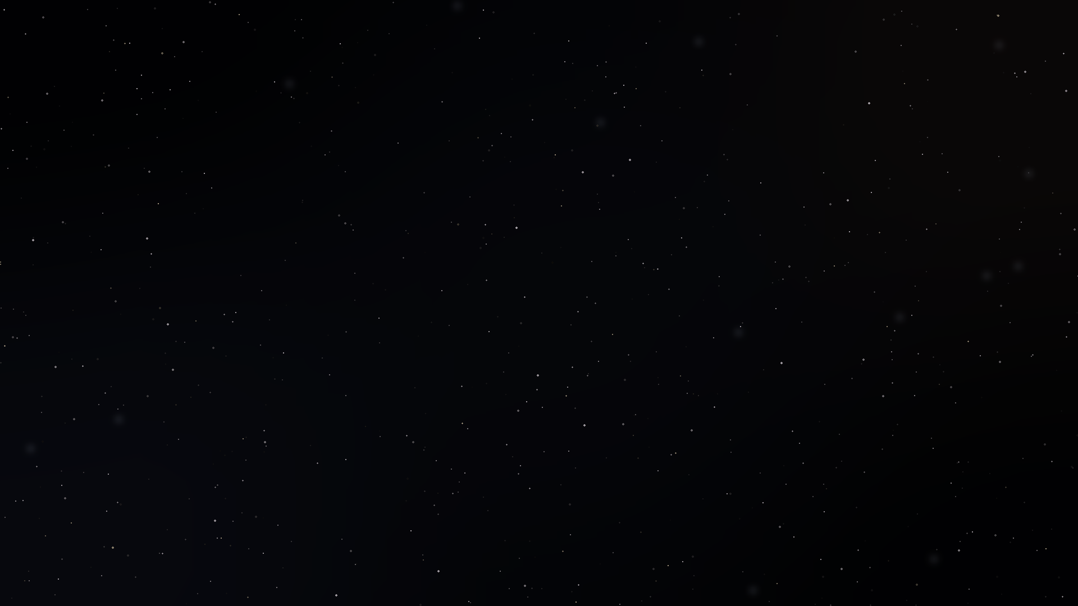


Your company is the Universe. Every seat is its own galaxy.
EOS® governs the universe: vision, traction, healthy.
VISIONARY
INTEGRATOR
SALES
OPERATIONS
FINANCE
#WeRunOnEOS2026

Slide 29

Inside the sales seat, lives…
SALES
#WeRunOnEOS2026

Slide 30
An entire solar system of its own.
Onboarding Process
Daily Performance Indicators (DPIs)
Coaching Cadence
Sales Hiring System
Sales
Process
SALES
Sales Cycle Entrance
& Exit Criteria
Sales-to-Service Handoff
AI Utilization
Assess & Evaluate
Account Ownership Standards
Sales Leadership Training
Strategic Gifting
Referral Engine

Slide 31
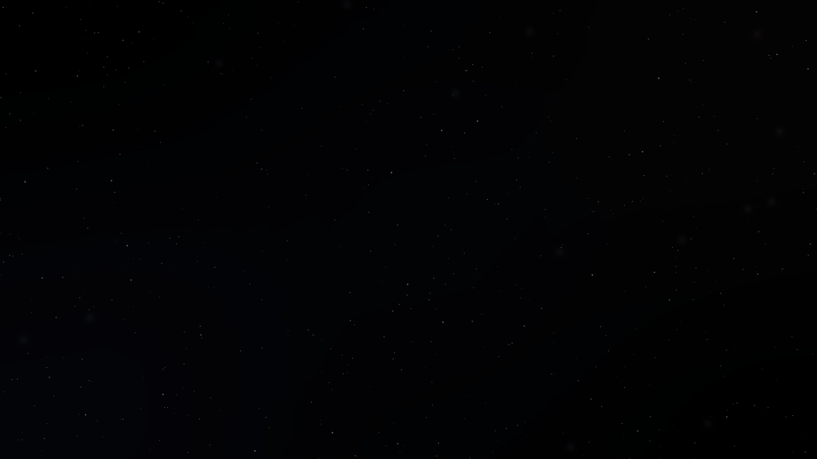
Most companies have never built this.
EOS® runs the company.
We run the sales engine inside it.
#WeRunOnEOS2026

Slide 32
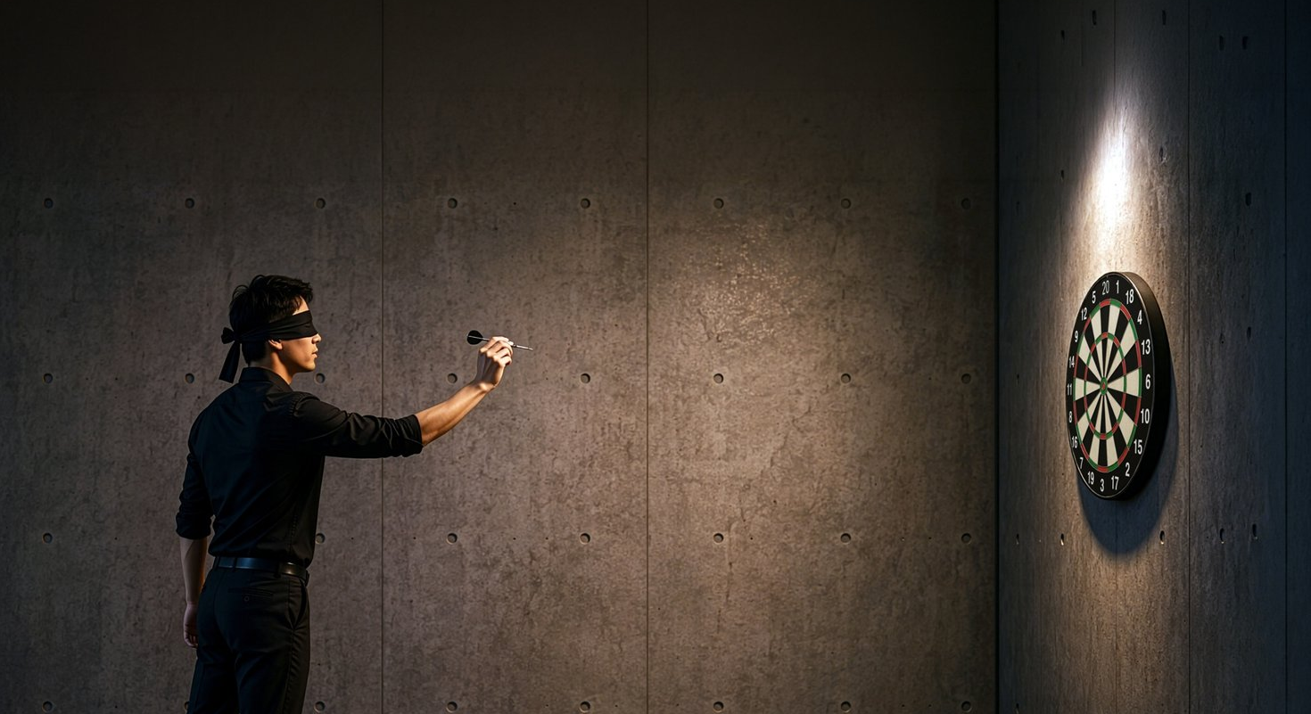
How most companies try to “fix” sales
#WeRunOnEOS2026

Slide 33









Conduct a sales training “event.”
Switch CRMs.
Hire “better” salespeople
Set higher, more unrealistic goals.
Promote your best salesperson to manager.”
Change comp plans to drive results.
#WeRunOnEOS2026

Slide 34
The 5 Cornerstones of Sales Execution™
Strategic Clarity
Structure Design
Skill Application
Performance Visibility
Stewardship in Action

Slide 35
Strategic Clarity
Identifying the clients’ problems you solve better than anyone else.
Why you win deals, why you don’t, and when to say no.
A clear strategy for where AI fits in your sales system and where it doesn’t.
35

Slide 36
Structure Design
Defined roles and responsibilities that eliminate overlap and confusion.
Clear accountability tied to specific activities and behaviors.
A clearly defined process for the transition from sales to service (after the sale is made).
36

Slide 37
Skill Application
Skills are developed through structured coaching, practice, and role play.
Growth is driven by tailored coaching plans, not one-size- fits-all training.
Execution improves because performance is observed, coached, and refined.
37

Slide 38
Performance Visibility
Daily Performance Indicators are tied directly to performance.
Stage-by-stage visibility to identify where deals are won or lost.
Clearly defined standards for what effective execution looks like at each stage of the sales process.
38

Slide 39
Stewardship in Action
Coaching that develops capability, not just compliance.
Onboarding that creates clarity, confidence, and early execution.
A culture driven by leadership, not management.
39

Slide 40

You can’t force performance.
But you can build an
environment where it’s
far more likely to happen.

Slide 41

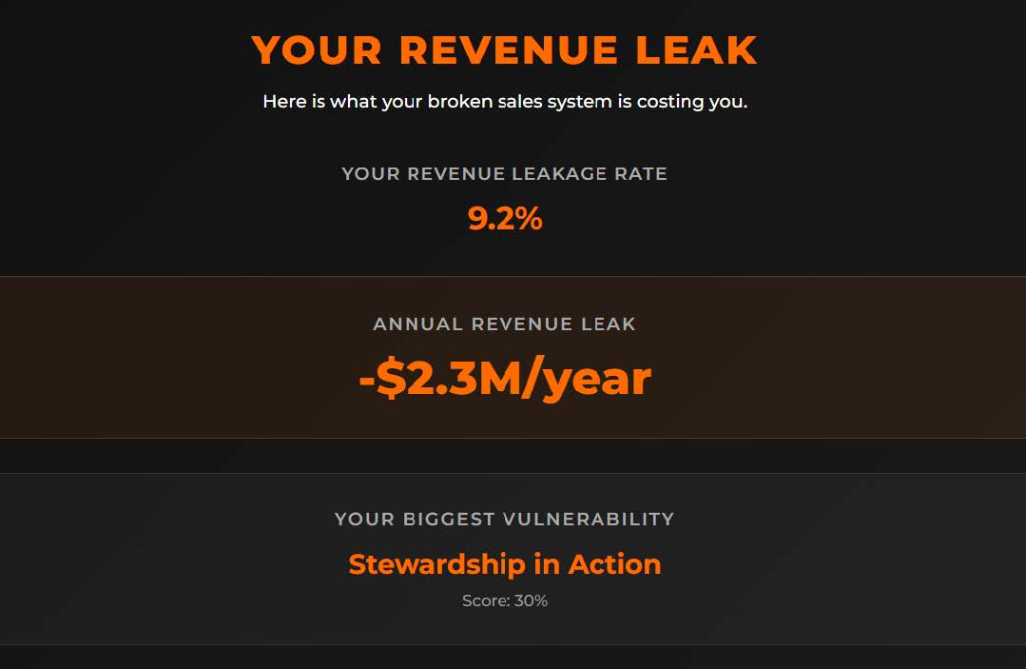
Sales System Reality Check™
Get the help you NEED!
#WeRunOnEOS2026

Slide 42
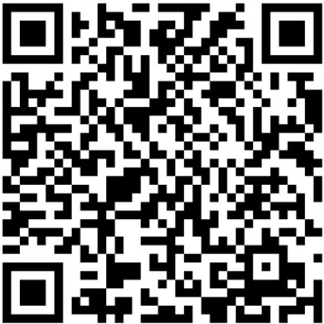
It’s FREE!
Live Zoom session w/leadership.
Identify your biggest revenue leak.
Clarity on how to fix the go kart!
#WeRunOnEOS2026
THE SYSTEM OF SELLING
42

Slide 43
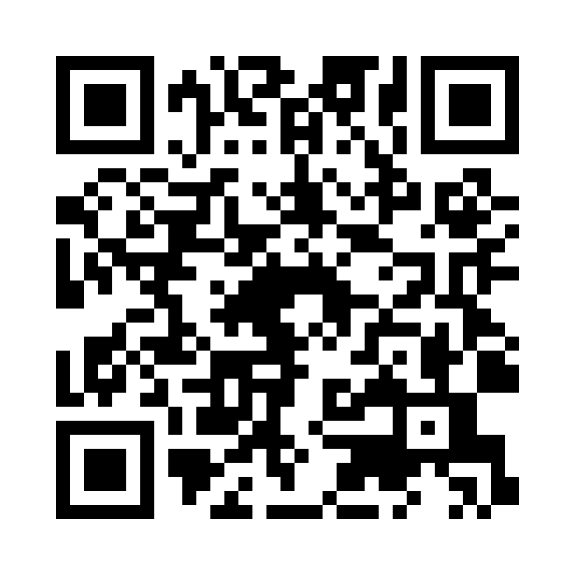
Session Survey
Scan the code to share quick feedback on this session.
Thank you for your feedback.
#WeRunOnEOS2026

